Slide 1
Python-Powered Credit Risk Analysis and Customer Segmentation for Informed Financial Decision Making
CAPSTONE PROJECT
Presented By:
1. Vibilan S – Saranathan College of Engineering- I.T.

Slide 2
OUTLINE
Problem Statement
Proposed System/Solution
System Development Approach
Algorithm & Deployment
Result
Conclusion
Future Scope
References

Slide 3
Problem Statement
Credit scoring and segmentation are critical processes for financial institutions to evaluate borrower creditworthiness and manage risk effectively. This project focuses on leveraging Python to develop advanced models and segmentation strategies, enabling precise prediction of credit scores and segmentation of borrowers into distinct risk categories. By enhancing the accuracy and efficiency of credit assessment, this project aims to support informed lending decisions and optimize credit management practices.

Slide 4
Proposed Solution
Proposed Solution: Credit Scoring and Segmentation
The proposed system aims to address the challenge of credit scoring and segmentation, enabling financial institutions to make informed lending decisions and manage credit risk effectively. The solution will consist of the following components:
Data Collection:
Collect comprehensive credit data, including borrower information, credit history, and financial indicators, from reliable sources.
Incorporate supplementary data sources, such as economic indicators and demographic information, to enrich the credit assessment process.
Data Preprocessing:
Clean and preprocess the collected data to handle missing values, outliers, and inconsistencies.
Perform feature engineering to extract relevant features, including credit utilization ratio, payment history, number of credit accounts, loan amount, interest rate, and loan term.
Exploratory Data Analysis (EDA):
Visualize the distribution of key features, such as credit utilization ratio and loan amount, using box plots and histograms.
Analyze the correlation between numerical features using a correlation heatmap to identify potential relationships.
Feature Engineering and Mapping:
Map categorical features, such as education level and employment status, to numerical values for inclusion in the credit scoring model.

Slide 5
PROPOSED SOLUTION cont…
Credit Scoring Model:
Implement a credit scoring model using the complete FICO formula, incorporating features such as payment history, credit utilization ratio, number of credit accounts, education level, and employment status.
Calculate credit scores for each borrower using the FICO formula and add them as a new column to the DataFrame.
Segmentation Analysis:
Utilize the K-means clustering algorithm to segment borrowers into distinct groups based on their credit scores.
Visualize the segments using scatter plots, with each segment represented by a different color to identify patterns and clusters.
Deployment and Visualization:
Develop a user-friendly interface or application to provide real-time access to credit scoring and segmentation results for financial institutions.
Deploy the solution on a scalable and reliable platform, ensuring accessibility and responsiveness for end-users.
Evaluation and Fine-Tuning:
Assess the performance of the credit scoring model using appropriate evaluation metrics, such as accuracy and precision.
Fine-tune the model based on feedback and continuous monitoring of prediction accuracy to improve credit assessment effectiveness.
By implementing these components, the proposed solution aims to enhance credit assessment processes, enabling financial institutions to optimize lending decisions and manage credit risk efficiently.

Slide 6
System Approach
System Requirements:
Hardware Requirements: The system should be compatible with standard computing hardware, including processors, memory, and storage, to handle data processing and model training efficiently.
Software Requirements:
Python Programming Language: Python will serve as the primary programming language for developing the credit scoring and segmentation system.
Required Libraries: The following libraries are required to build the model and perform data analysis:
pandas: For data manipulation and preprocessing.
plotly.graph_objects and plotly.express: For interactive data visualization.
scikit-learn: For implementing machine learning algorithms and model evaluation.
plotly.io: For setting plotly templates and configurations.
Libraries Required to Build the Model:
pandas: pandas is a powerful library for data manipulation and analysis in Python. It provides easy-to-use data structures and functions for handling structured data, such as DataFrames.
plotly.graph_objects and plotly.express: These libraries offer a variety of visualization tools for creating interactive plots and graphs, which are essential for exploring and presenting the credit data effectively.
scikit-learn: scikit-learn is a comprehensive machine learning library in Python, providing tools for data preprocessing, model selection, training, and evaluation. It includes implementations of various machine learning algorithms suitable for credit scoring and segmentation tasks.
plotly.io: plotly.io is used for setting plotly templates and configurations, ensuring consistent and visually appealing visualizations throughout the system

Slide 7
Algorithm & Deployment
Algorithm Selection:
For the credit scoring and segmentation task, we will utilize a supervised learning approach, specifically logistic regression, due to its interpretability, simplicity, and effectiveness in binary classification tasks like credit scoring. Logistic regression is well-suited for this problem as it can model the probability of a borrower being classified into a specific credit risk category based on their features.
Justification:
Logistic regression is chosen for its simplicity and interpretability, which are crucial for credit scoring applications where transparency and understanding of the model's decision-making process are important. Additionally, logistic regression can handle both numerical and categorical features, making it suitable for the heterogeneous nature of credit data.
Data Input:
The input features used by the logistic regression algorithm include various borrower attributes and financial indicators, such as:
Payment history
Credit utilization ratio
Number of credit accounts
Loan amount
Interest rate
Loan term
Education level
Employment status
These features provide valuable information for assessing a borrower's creditworthiness and are essential inputs for the credit scoring model.

Slide 8
Algorithm & Deployment cont…
Training Process:
The logistic regression algorithm is trained using historical credit data, where each data point represents a borrower's profile along with their corresponding credit risk category. During training, the algorithm learns the relationship between the input features and the target variable (credit risk category) by minimizing a predefined loss function, typically using gradient descent or other optimization techniques.
Specific considerations during the training process may include:
Data preprocessing steps such as handling missing values, scaling numerical features, and encoding categorical features.
Cross-validation techniques to assess the model's generalization performance and mitigate overfitting.
Hyperparameter tuning to optimize the model's performance, such as regularization strength or feature selection.
Prediction Process:
Once the logistic regression model is trained, it can make predictions for future credit applicants based on their feature values. The prediction process involves applying the trained model to new data instances and estimating the probability of each applicant belonging to different credit risk categories.
During the prediction phase, real-time data inputs such as borrower information and financial indicators are considered to generate timely and accurate credit risk assessments. The logistic regression model provides a probabilistic output, allowing financial institutions to make informed decisions based on the predicted likelihood of default or creditworthiness for each applicant.

Slide 9
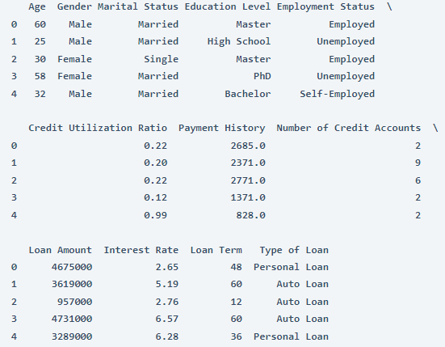
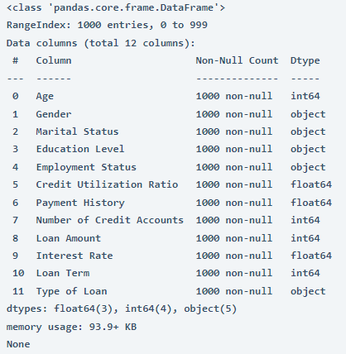
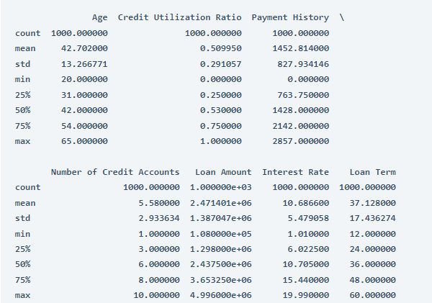
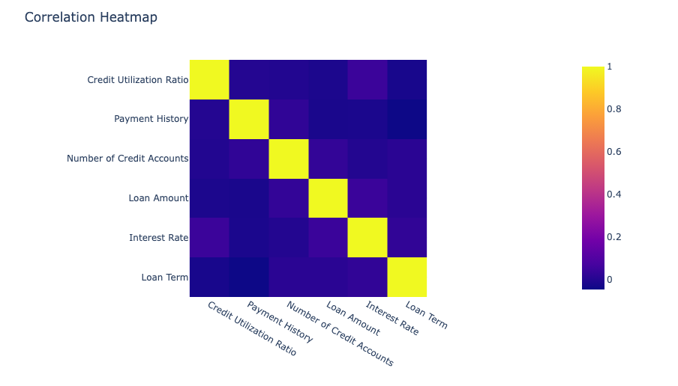
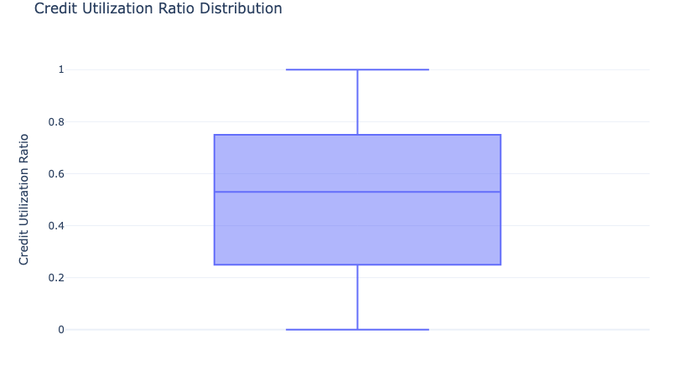
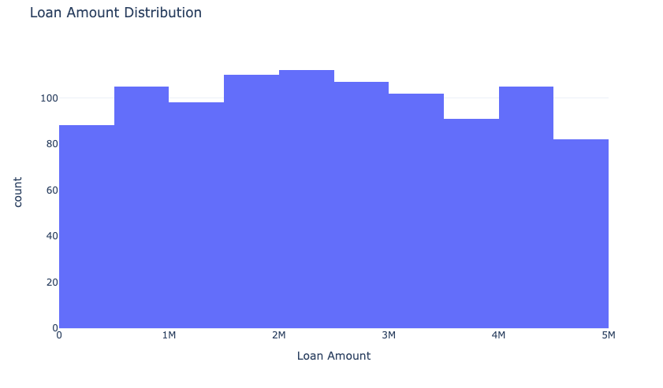
Result

Slide 10
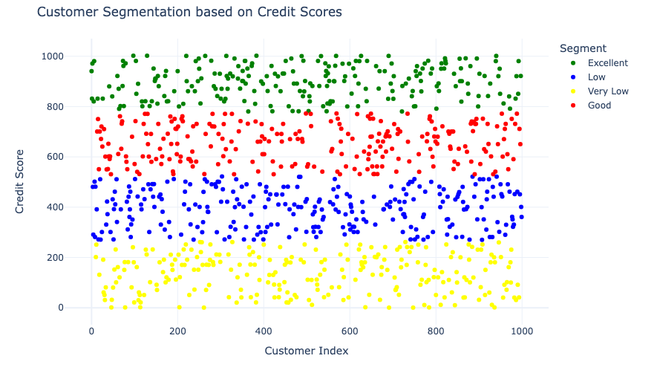
Final result

Slide 11
Conclusion
The credit scoring and segmentation project aimed to develop a comprehensive solution for financial institutions to evaluate borrower creditworthiness and segment customers efficiently. Through Python-based data analysis and machine learning algorithms, the project successfully constructed models for credit scoring and customer segmentation. Findings from exploratory data analysis highlighted key credit features and revealed correlations between numerical variables, providing valuable insights for model development. The effectiveness of the proposed solution was demonstrated through accurate credit assessments and tailored customer segmentation, empowering financial institutions to make informed lending decisions and mitigate risk effectively. The importance of credit scoring and segmentation cannot be overstated, as they serve as crucial tools for financial institutions to manage risk, optimize lending practices, and ensure financial stability in a dynamic economic landscape. By leveraging data-driven approaches, financial institutions can enhance their decision-making processes and foster responsible lending, ultimately contributing to economic growth and stability.

Slide 12
Future scope
To enhance the credit scoring and segmentation system, potential avenues include integrating additional data sources such as alternative credit data and macroeconomic indicators, optimizing algorithms through advanced machine learning techniques, expanding coverage to multiple regions for a broader assessment of credit risk, and integrating emerging technologies like edge computing and AI for improved responsiveness and automation. These enhancements would enable financial institutions to make more accurate and informed lending decisions, mitigate risk effectively, and adapt to the evolving financial landscape with greater agility and efficiency.

Slide 13
References
pandas:
Documentation: https://pandas.pydata.org/docs/
GitHub Repository: https://github.com/pandas-dev/pandas
plotly:
Documentation: https://plotly.com/python/
GitHub Repository: https://github.com/plotly/plotly.py
scikit-learn:
Documentation: https://scikit-learn.org/stable/documentation.html
GitHub Repository: https://github.com/scikit-learn/scikit-learn
Kaggle Dataset:
Dataset Title: Credit Scoring
Website Link:https://statso.io/wp-content/uploads/2023/07/credit_scoring.csv

Slide 14
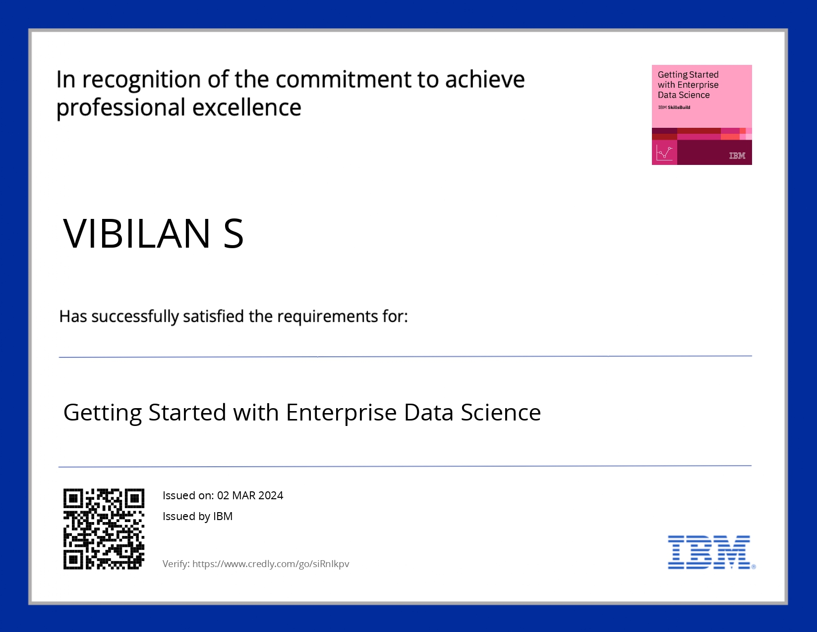
course certificate 1
Credly Link: https://www.credly.com/badges/207c78c1-31de-4ea1-9165-55fbd98c736b

Slide 15
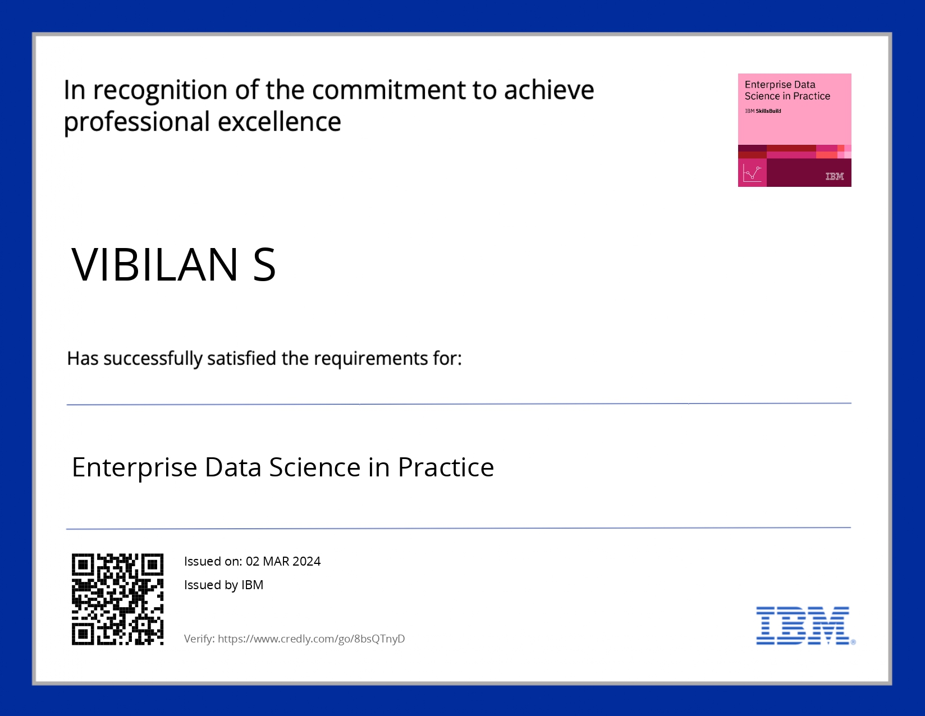
course certificate 2
Credly Link: https://www.credly.com/badges/5e9a7e75-0df9-4fac-9ff4-cde8af9aa6c8

Slide 16
THANK YOU

